Slide 1
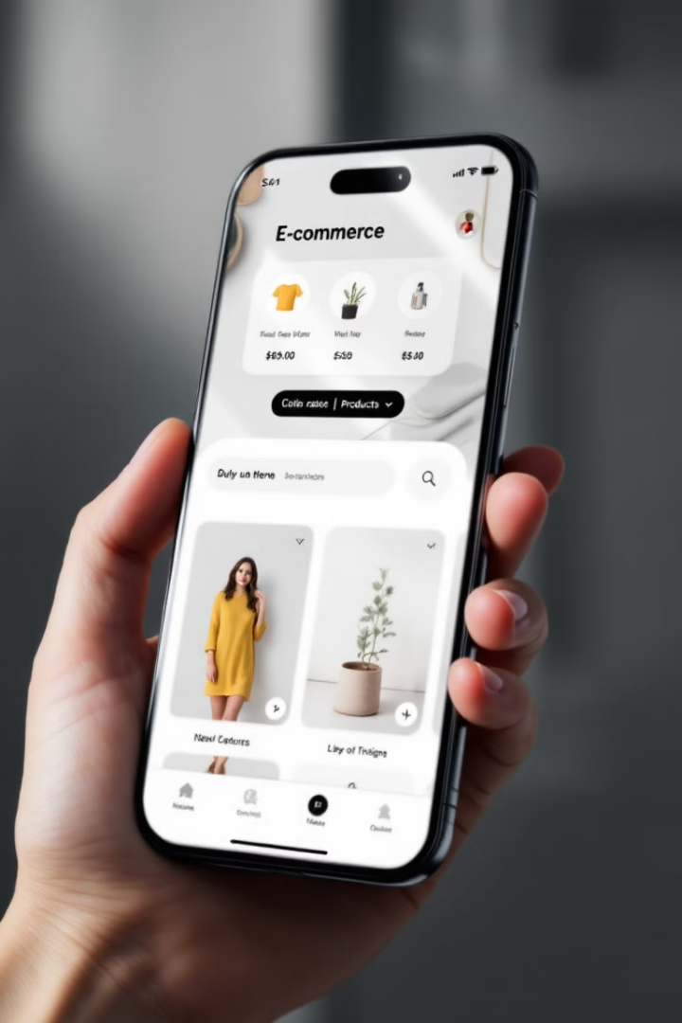
Flutter E-Commerce App Architecture
This presentation outlines the architecture and key features of a modular Flutter e-commerce application. We'll explore how the app uses providers for state management, implements product and cart functionality, and creates an interactive user interface.
Haseeb Tariq 232506
Abdullah Ahsan 232449

Slide 2





Modular Structure
Models
Define data structures like Product
Providers
Manage state for products and cart
Screens
Define UI for different app views
Widgets
Reusable UI components

Slide 3
State Management with Providers
ProductsProvider
CartProvider
Manages product data and operations
Handles cart functionality and calculations
The app uses the Provider package for efficient state management, ensuring app-wide state changes are handled without manually passing data down the widget tree.

Slide 4
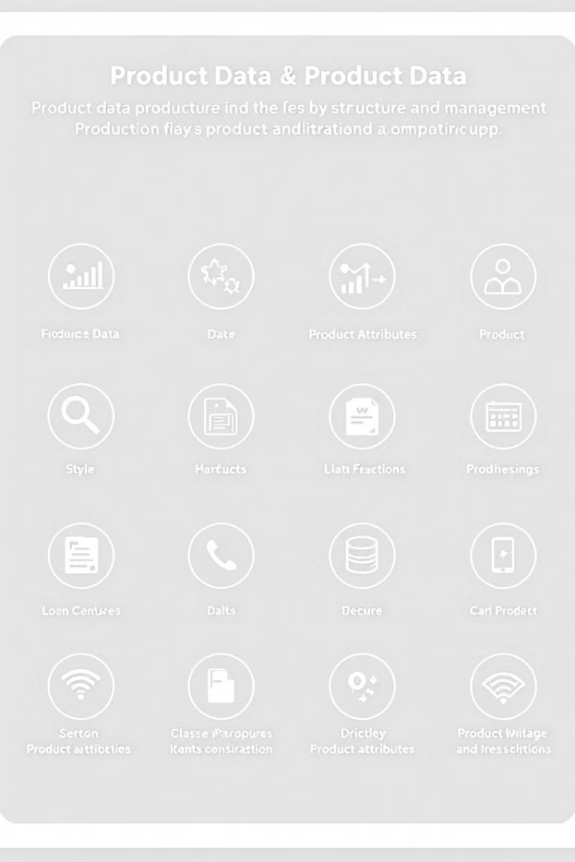
Product Management
Product Model
ProductsProvider
Defines structure for product data (id, title, description, price, imageUrl)
Manages list of products and provides methods to access and manipulate product data
Scalable Design
Easy to add, update, or retrieve product details as the app grows

Slide 5
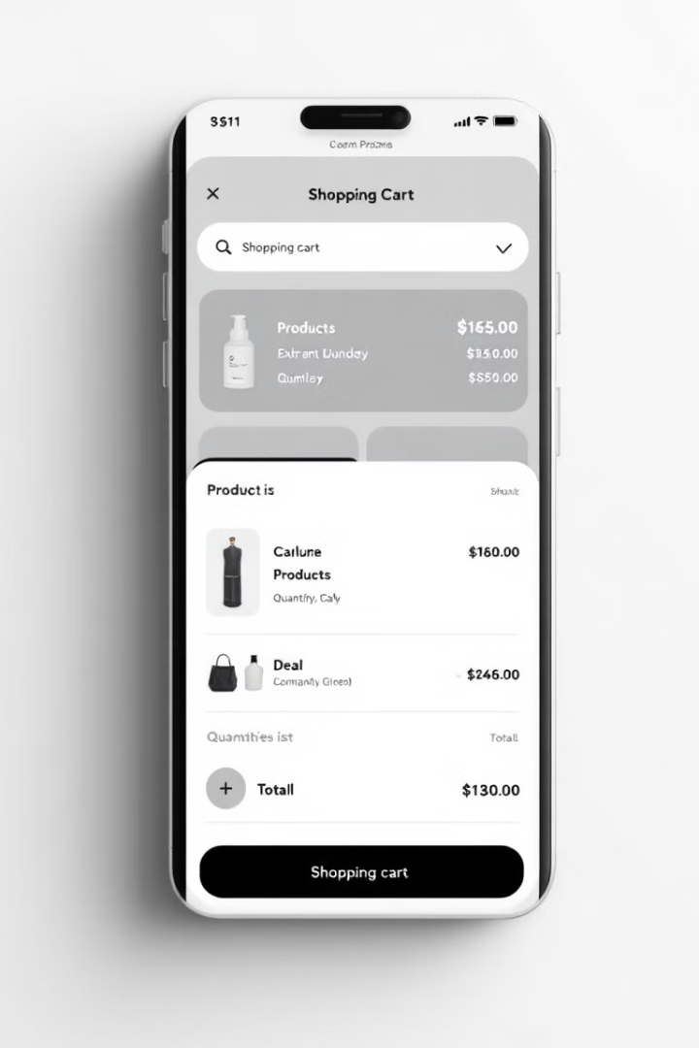
Cart Functionality
1
Add to Cart
Users can add products to their cart from product grid or detail screen
2
Update Quantity
Cart automatically updates quantity for existing items
3
Calculate Total
CartProvider calculates total amount and item count
4
Remove Items
Users can remove items from the cart

Slide 6

Dynamic UI Updates
Consumer Widgets
Real-time Updates
Wrap specific parts of the UI to listen for state changes
UI automatically refreshes when cart or product data changes
Efficient Rendering
Only affected parts of the UI are rebuilt, improving performance

Slide 7



Navigation and Screens
HomeScreen
1
Main entry point with product grid
ProductDetailScreen
2
Displays detailed product information
CartScreen
3
Shows cart contents and total
The app uses named routes for efficient navigation between screens, enhancing user experience and maintainability.

Slide 8




Future Enhancements
Backend Integration
Responsive Design
Connect to real API for dynamic product data and user authentication
Optimize layout for various screen sizes and orientations
Checkout Process
Implement secure payment gateway and order management
The modular architecture allows for easy expansion and integration of new features as the app grows.

